Slide 1
Setup and management of OCLC Services accounts for access to WorldShare® Interlibrary Loan
July 2013
OCLC Training and Support
Michael Cosentino
Senior Training Coordinator
OCLC

Slide 2

Agenda
Why are we making change to user accounts?
Distinction between Admin and User accounts in WorldShare® ILL
Best Practice for creating accounts
Searching for, editing, and disabling accounts
How to find a forgotten custom Web address and/or password for WorldShare® ILL
How to manage accounts for multiple OCLC symbols
FAQ site, Customer Support info

Slide 3
Why are we making change to user accounts?
WorldShare® ILL will completely replace the current system by January 3, 2014.
New account replaces 9-digit account number and password (100-xxx-xxx)
Single sign-on: Log in once for access to multiple services and tools that include:
  WorldShare ® Interlibrary Loan
  Article Exchange
  OCLC Policies Directory
  OCLC Service Configuration
  Other services, including WMS
Notes:
The big reason we are making the change is because ILL is moving to the WorldShare ILL service, which is on a new software platform. This new platform allows OCLC to continually improve and enhance the service, whereas the current platform that ILL is on, FirstSearch, does not allow us to make any updates. WorldShare ILL will completely replace WorldCat Resource Sharing/FirstSearch by the end of this calendar year.
[CLICK]
To use WorldShare ILL, a new account must be created. You cannot use your current “one hundred” number to log in to WorldShare ILL- it will not work.
[CLICK]
Another reason for the change is that OCLC is moving towards a single sign-on architecture for its services- we want to eliminate the need for libraries to have multiple log-ins for the OCLC services they use, as well as the need to have OCLC create new accounts once they are needed. Some examples of the services your new OCLC Service account will allow you to access include WorldShare ILL, Article Exchange, Policies Directory, Service Configuration, and other services as they become available or you subscribe to them- such as WMS, etc.

Slide 4
Distinction between Admin and User accounts in WorldShare® ILL
Privilege Level | Description
Everyone | This is the default account level. Please keep this option selected!
WORLDSHARE_ILL_ADMIN | This type of account is designed for library staff members who are responsible for creating or modifying other staff accounts for WorldShare Interlibrary Loan.
WORLDSHARE_ILL_USER | This type of account is designed for most library staff using WorldShare Interlibrary Loan.
Notes:
We want to note that there are two types of OCLC Service accounts that can be created for WorldShare ILL- an Admin account, and a User account.
There is not much difference between the two, to be honest. The Admin account simply has the extra advantage of being able to access, manage and create other user accounts.
All access to functionality and other services is the same, whether you have an Admin or User account. So yes, this does mean that someone with a User account can access Service Configuration or the Policies Directory. But the same is true in WorldCat Resource Sharing, unless a new password is created for the Admin Module login, to prevent access to things like Custom Holdings and Constant Data info that is stored there.
The Everyone designation should be selected no matter what- in fact, we are contemplating leaving this box checked and making it impossible for anyone to uncheck it. If you uncheck this box, you will not see anything when logged in to your library’s WorldShare ILL custom Web address.

Slide 5
Best Practices for creating accounts
Three scenarios:
  All users have & create their own accounts (strongly recommended)
  Create a single account for entire library that’s shared with everyone working in ILL
  One person with Admin account creates all other User Names for colleagues and sets privileges (not recommended)
Notes:
To illustrate the best practices associated with creating accounts, we have three scenarios:
All users have & create their own accounts; privileges don’t matter (strongly recommended)
Create a single account for entire library that’s shared with everyone working in ILL
One person with Admin account creates all other accounts for colleagues and sets privileges
Let’s look at each one in more detail.

Slide 6
Best Practices for creating accounts
Process is the same for first two scenarios:
  All users have & create their own accounts (strongly recommended)
  Create a single account for entire library that’s shared with everyone working in ILL
  Go to Getting Started page, follow link in Step #1 to create account:
  http://www.oclc.org/en-US/worldshare-ill/getting-started.html
Notes:
If you plan on having everyone at your institution create their own accounts, or if you plan on just having one account created for everyone to share, the process to create account will be the same. You’ll want to start at the Getting Started page on the OCLC website:
http://www.oclc.org/en-US/worldshare-ill/getting-started.html
Click link and begin demonstrating process.
How do you know which 9 digit number to use? Well, if you log in at firstsearch.oclc.org and see a box with the title “Staff View” in the top left-hand corner, that’s your ILL account, and that is the authorization and password to use to create new WSILL user name and password.

Slide 7
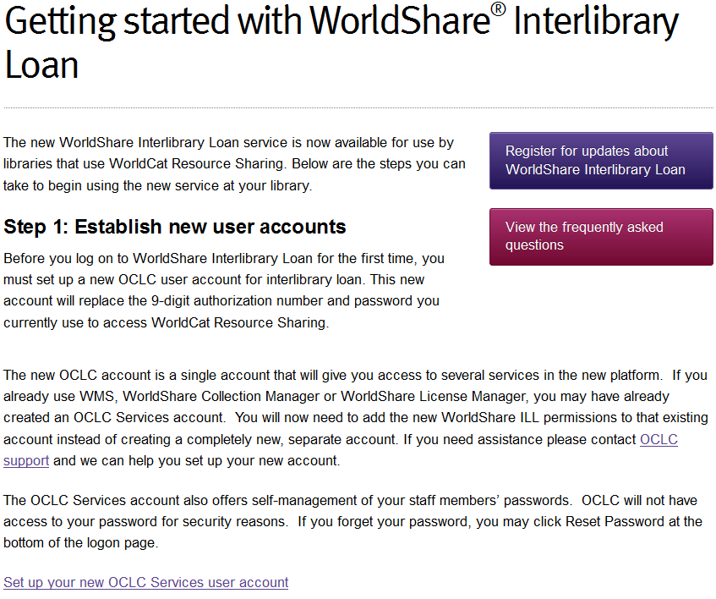
Notes:
To start, click on green Create Account button on left

Slide 8
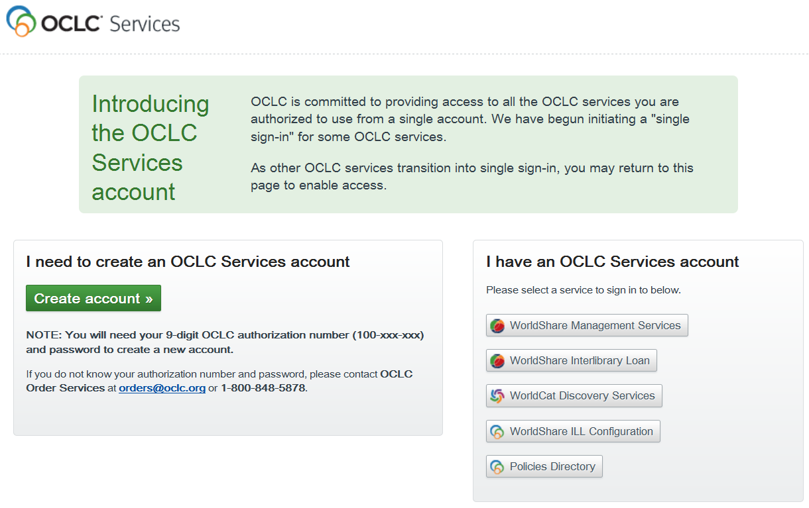
Best Practices for creating accounts
Notes:
To start, click on green Create Account button on left

Slide 9
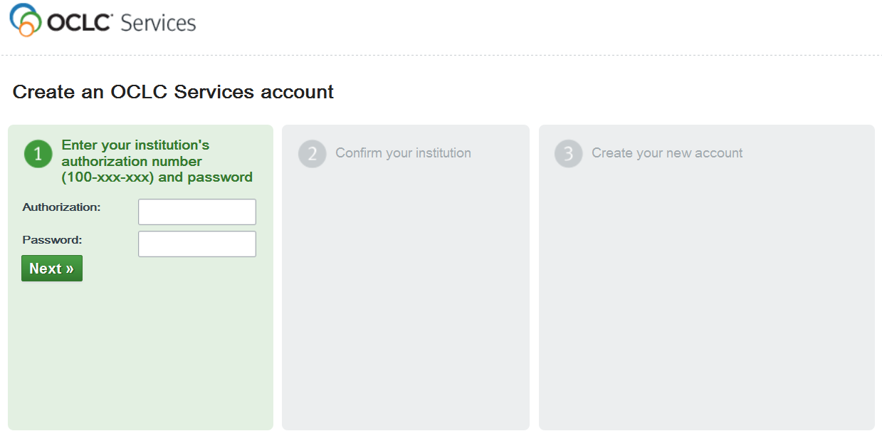
Best Practices for creating accounts

Slide 10
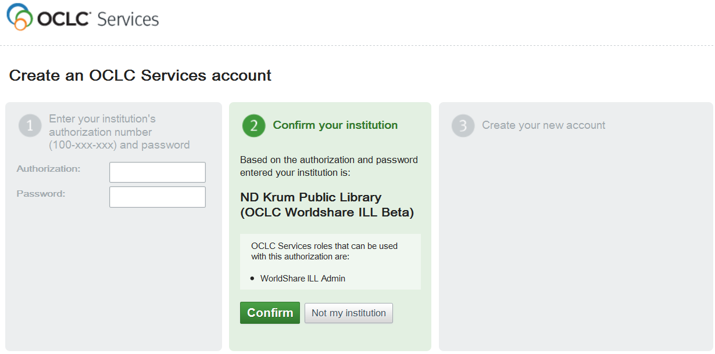
Best Practices for creating accounts
Notes:
Verify your institution’s name appears; click confirm to move on to Step 3.

Slide 11
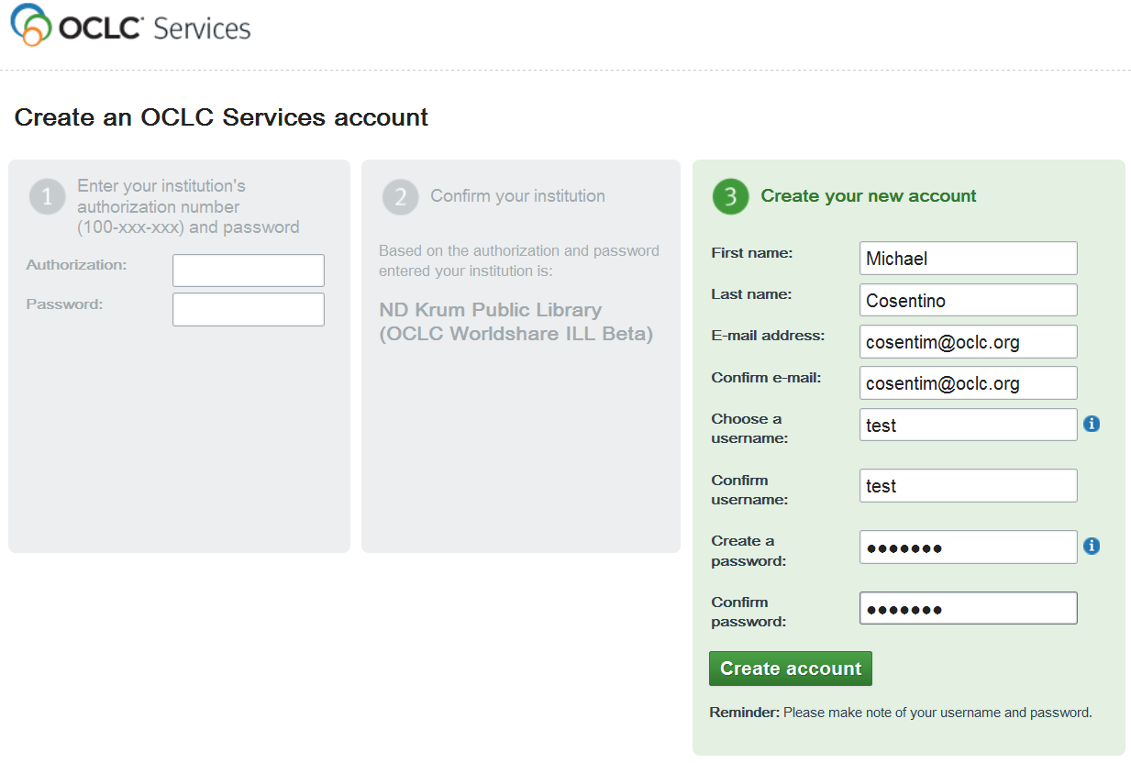
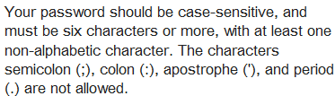
Best Practices for creating accounts
All fields required!
Write down / remember your
User Name and Password!
Notes:
All fields are required for Step 3. Remember your User Name and Password- write it down, make a note of it, etc.

Slide 12
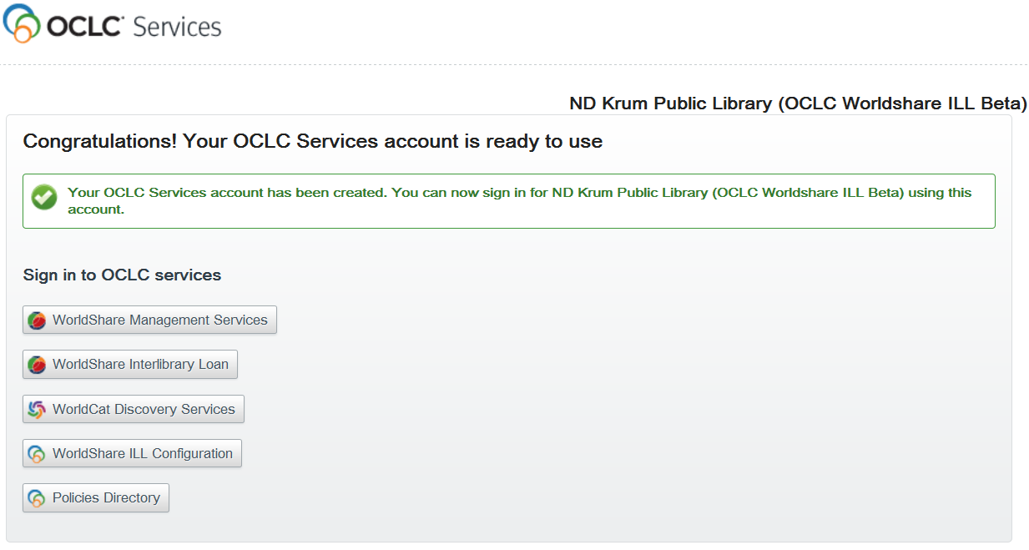
Best Practices for creating accounts
Click here to log in to WorldShare® ILL
Notes:
Confirmation message will appear- we have been successful creating account.
To access WorldShare ILL, click button for it on the page.

Slide 13
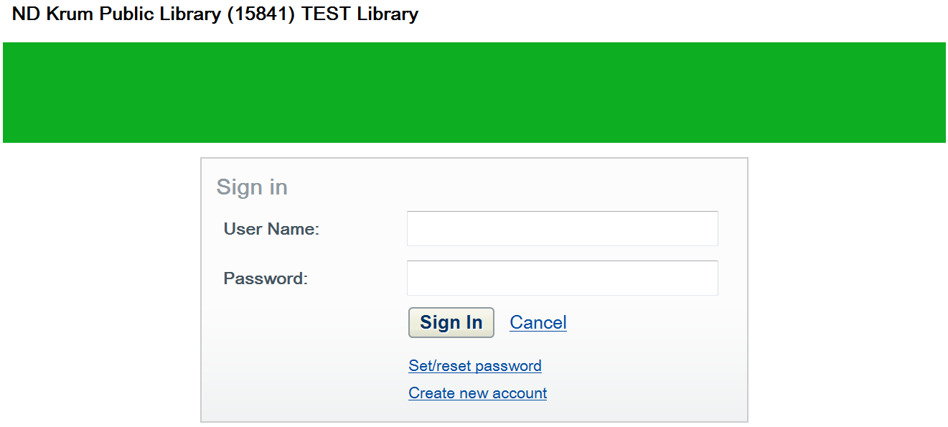
Log In to WorldShare ILL
Notes:
Login with User Name and Password you just created.

Slide 14
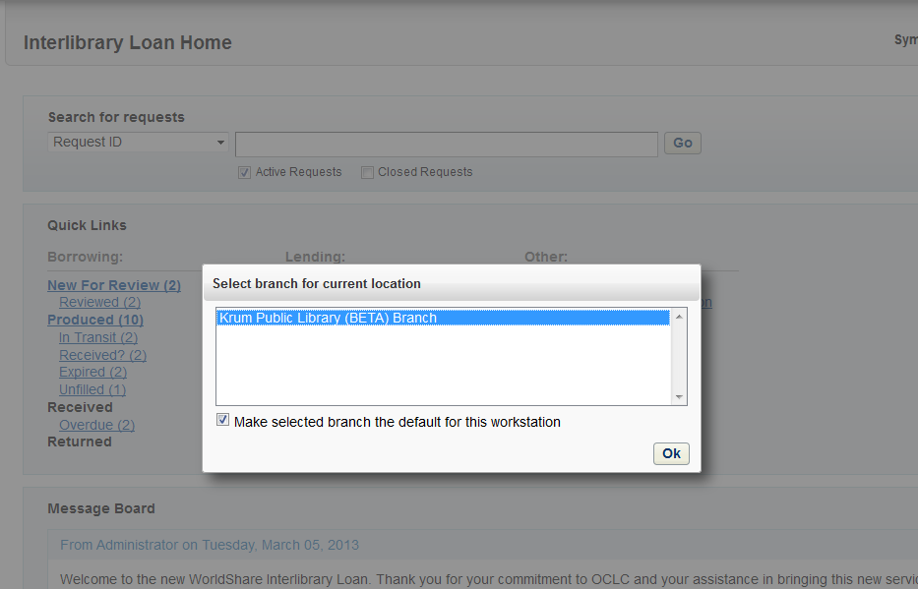
Log In to WorldShare ILL
Notes:
Highlight library name and then click OK. Even if your library doesn’t have branches, you’ll need to do this. Hitting OK sets a cookie in your Web Browser so that WSILL will remember you when you come back.

Slide 15
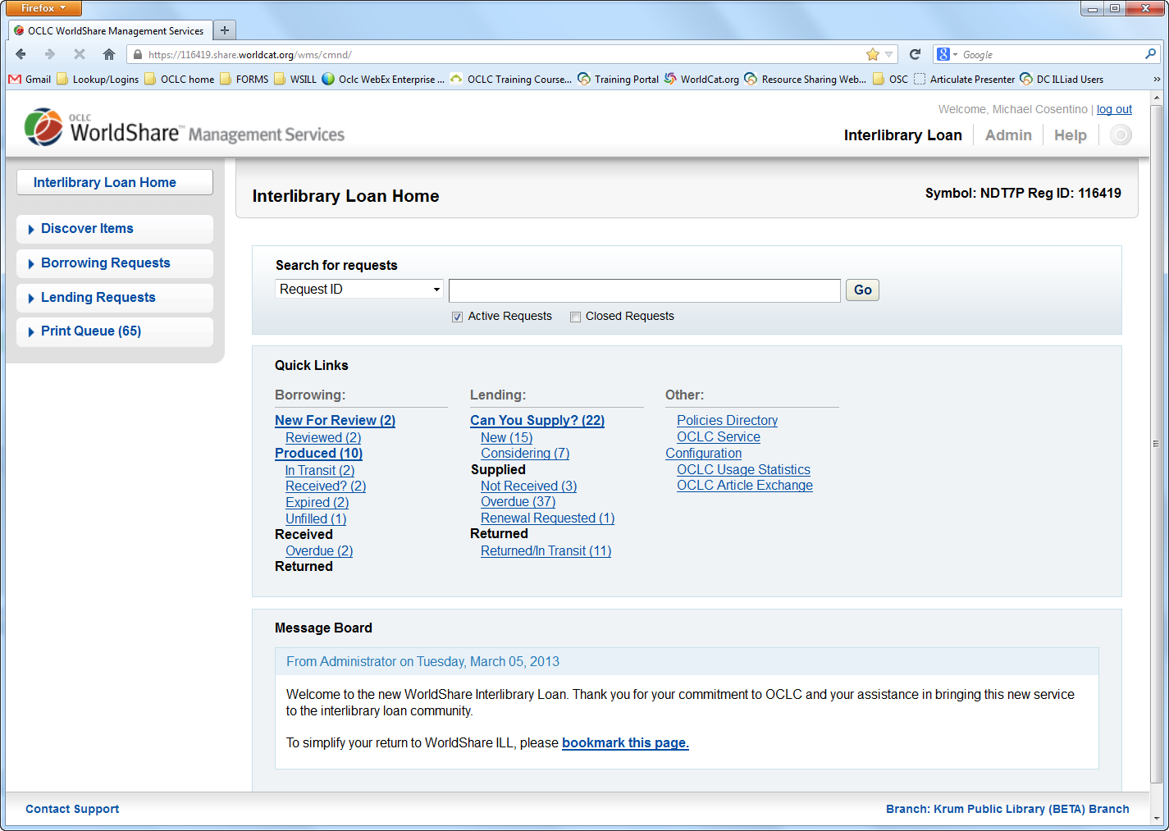
Bookmark Your Custom Web Address!
Notes:
Branch message will go away, and then you are inside WorldShare ILL. If/when you see ILL Home Screen, you were successful creating account and accessing the new system.
The first thing you’ll want to do is bookmark the URL in the address bar- this address if your library’s custom web address for WorldShare ILL.

Slide 16
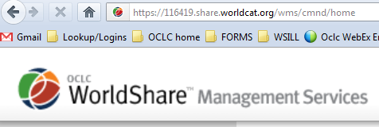
Bookmark Your Custom Web Address!
Once inside, BOOKMARK URL IN THE ADDRESS BAR!
Holding down the Ctrl and D keys together on your keyboard should allow you to bookmark the address in your browser.
This is the web address you’ll use to log in to WorldShare ILL
Notes:
Emphasize/re-emphasize bookmarking URL.

Slide 17

Best Practices for creating accounts
Account Created is an Administrative Account
  Can Manage/create other institutional staff accounts (User Accounts)
  User accounts have same access to functionality as Admin accounts
Notes:
Only difference between an Admin account and a User account in WSILL is that the Admin account has the power to create User accounts. That’s it- everything else, including access to functionality, is the same with both accounts.

Slide 18
Best Practices for creating accounts
Third scenario has its own procedure:
  One person with Admin account creates all other User Names for colleagues and sets privileges (not recommended)
    Accounts created this way must have a link sent to colleague’s email address.
    Colleague has 24 hours to click on link provided in email to complete account creation process (i.e., create their own password)
    See this tutorial for more info: http://oc.lc/pSszCs
Notes:
The third scenario involves using the Admin functionality in the WSILL interface to create User Names on behalf of colleagues.
However, you can only create a User Name for your colleague- not their password. They will have to create their own password.
[CLICK]
Once you create a User Name for a colleague, you can click a button to have a link sent to your colleague’s email address, so that they can complete the account creation process.
[CLICK]
BUT, your colleague will only have 24 hours to use that link in the email. If that 24 hour window has expired, you’ll have to go into the Admin section of wSILL and generate a new link to be sent to your colleague, so that they can click on it and create their own password. For this reason, we do not recommend setting up accounts this way. Much easier to have everyone set up their own accounts.

Slide 19
Searching for, editing, and disabling accounts
From Admin section of WorldShare® ILL:
  Can use an asterisk (*) to search for all accounts, or search by name
  Edit buttons are to the right-hand side of page
  Accounts cannot be deleted, only disabled

Slide 20
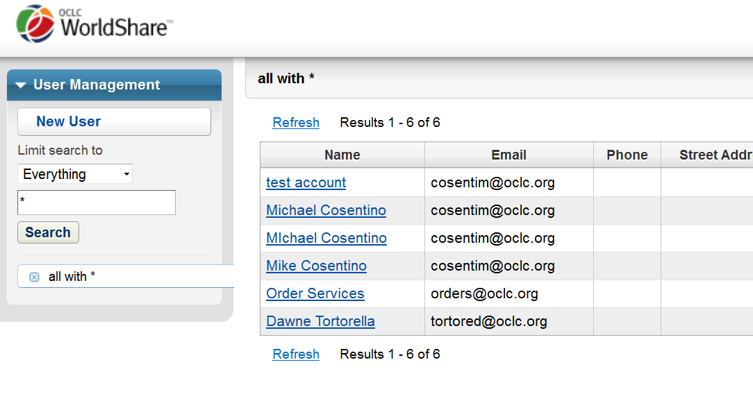
Searching for, editing, and disabling accounts
  Can use an asterisk (*) to search for all accounts, or search by name

Slide 21
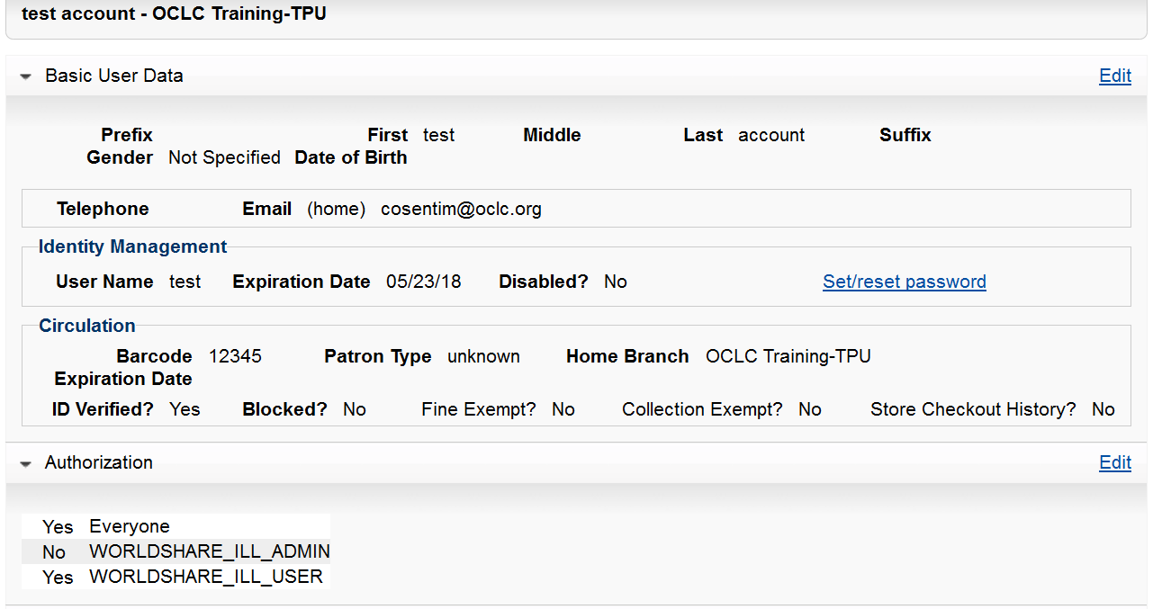
Searching for, editing, and disabling accounts
  Edit buttons are to the right-hand side of page

Slide 22
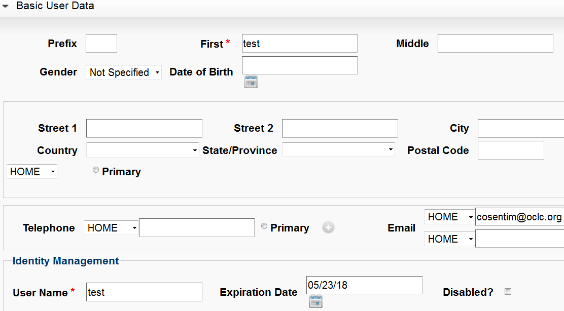
Searching for, editing, and disabling accounts
  Accounts cannot be deleted, only disabled

Slide 23
How to find a forgotten custom Web address for WorldShare® ILL
  Go back to Getting Started page: http://www.oclc.org/en-US/worldshare-ill/getting-started.html
Click link under Step 1 for “Set up your new OCLC Services user account”
Click on WorldShare® ILL link on right (under “I have an OCLC Services account”)
Enter your symbol, click on it when it appears, then click continue; log in & bookmark
Notes:
If you have forgotten your institution’s custom web address for WorldShare ILL, here are the steps to follow to get it back:
http://www.oclc.org/en-US/worldshare-ill/getting-started.html
Demo process as outlined in slide

Slide 24
How to find a forgotten custom Web address for WorldShare® ILL
Notes:
If you have forgotten your institution’s custom web address for WorldShare ILL, here are the steps to follow to get it back:
http://www.oclc.org/en-US/worldshare-ill/getting-started.html
Demo process as outlined in slide

Slide 25
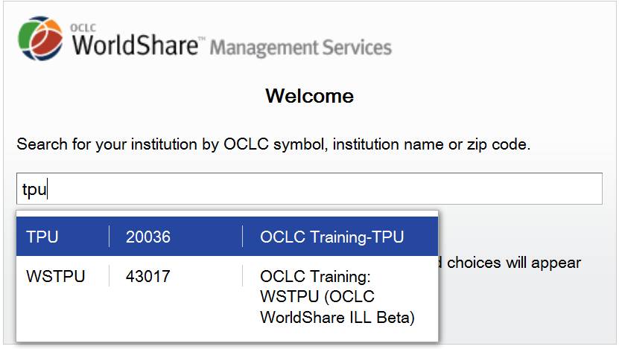
How to find a forgotten custom Web address for WorldShare® ILL
Notes:
If you have forgotten your institution’s custom web address for WorldShare ILL, here are the steps to follow to get it back:
http://www.oclc.org/en-US/worldshare-ill/getting-started.html
Demo process as outlined in slide

Slide 26
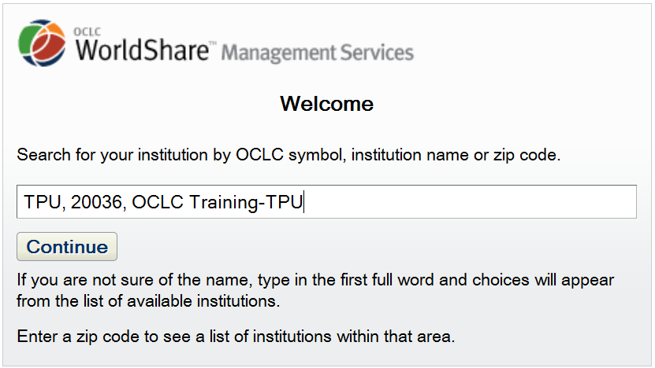
How to find a forgotten custom Web address for WorldShare® ILL
Notes:
If you have forgotten your institution’s custom web address for WorldShare ILL, here are the steps to follow to get it back:
http://www.oclc.org/en-US/worldshare-ill/getting-started.html
Demo process as outlined in slide

Slide 27
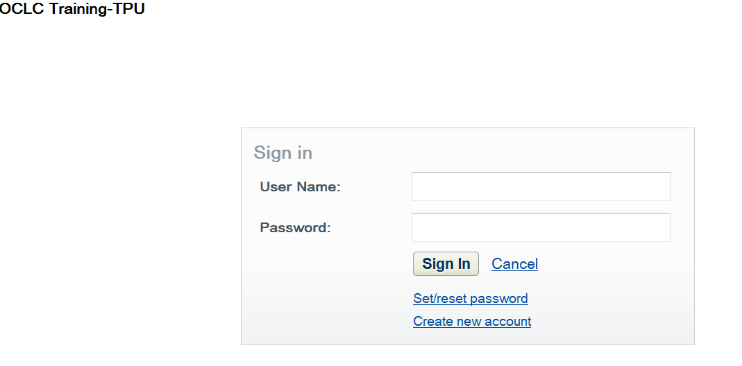
How to find a forgotten custom Web address for WorldShare® ILL
Notes:
If you have forgotten your institution’s custom web address for WorldShare ILL, here are the steps to follow to get it back:
http://www.oclc.org/en-US/worldshare-ill/getting-started.html
Demo process as outlined in slide

Slide 28
Bookmark Your Custom Web Address
Notes:
bookmark the URL in the address bar- this address if your library’s custom web address for WorldShare ILL.

Slide 29
How to replace a forgotten password for WorldShare® ILL
  Go to your library’s custom Web address
Click “Set/reset password” link
Enter your User Name, click “Request new password”
An email will be sent with instructions and link to click to create new password.
Must click this link within 24 hours!!!
Notes:
If you have forgotten your password for WorldShare ILL, here are the steps to get it back:
Go to your library’s custom Web address
Click “Set/reset password” link
Enter your User Name, click “Request new password”
An email will be sent with instructions and link to click to create new password.
Must click this link within 24 hours!!!
Demo process as outlined in slide

Slide 30
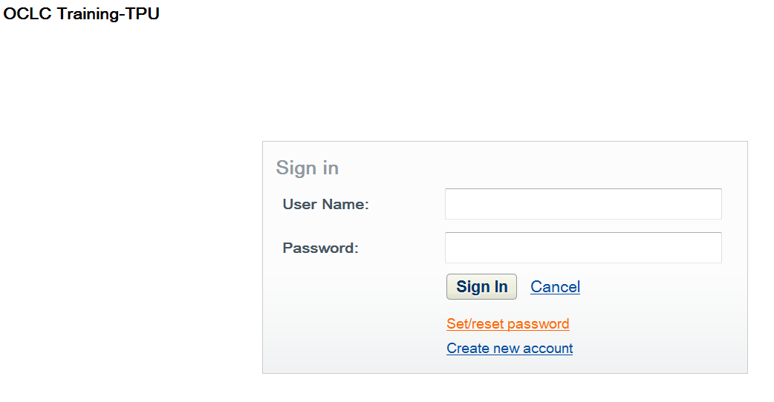
How to replace a forgotten password for WorldShare® ILL
Notes:
If you have forgotten your password for WorldShare ILL, here are the steps to get it back:
Go to your library’s custom Web address
Click “Set/reset password” link
Enter your User Name, click “Request new password”
An email will be sent with instructions and link to click to create new password.
Must click this link within 24 hours!!!
Demo process as outlined in slide

Slide 31
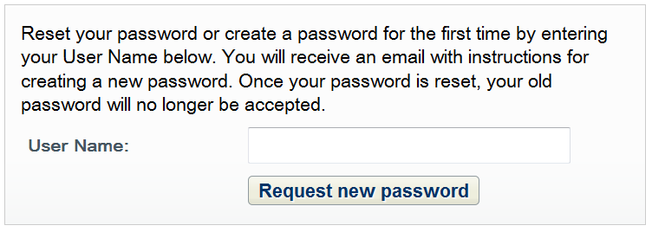
How to replace a forgotten password for WorldShare® ILL
Notes:
If you have forgotten your password for WorldShare ILL, here are the steps to get it back:
Go to your library’s custom Web address
Click “Set/reset password” link
Enter your User Name, click “Request new password”
An email will be sent with instructions and link to click to create new password.
Must click this link within 24 hours!!!
Demo process as outlined in slide

Slide 32
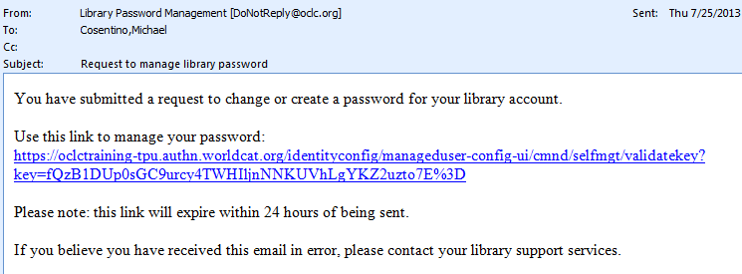
How to replace a forgotten password for WorldShare® ILL
This link must be clicked on within 24 hours of being sent!!!
Notes:
If you have forgotten your password for WorldShare ILL, here are the steps to get it back:
Go to your library’s custom Web address
Click “Set/reset password” link
Enter your User Name, click “Request new password”
An email will be sent with instructions and link to click to create new password.
Must click this link within 24 hours!!!
Demo process as outlined in slide

Slide 33
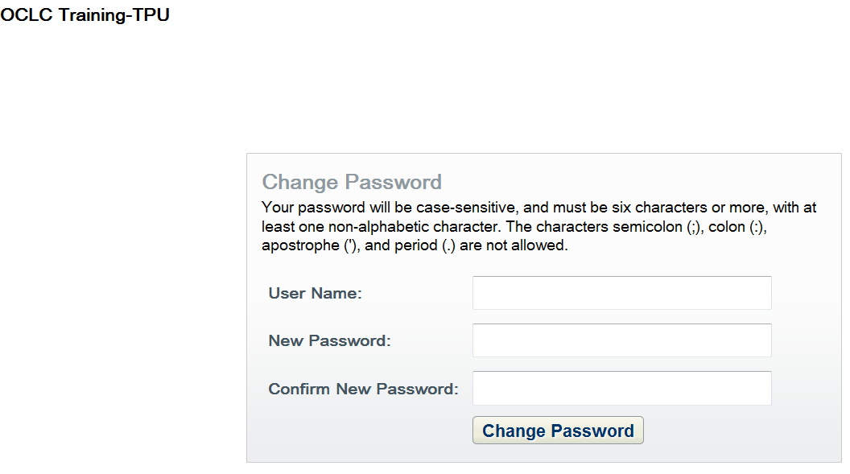
How to replace a forgotten password for WorldShare® ILL
Notes:
If you have forgotten your password for WorldShare ILL, here are the steps to get it back:
Go to your library’s custom Web address
Click “Set/reset password” link
Enter your User Name, click “Request new password”
An email will be sent with instructions and link to click to create new password.
Must click this link within 24 hours!!!
Demo process as outlined in slide

Slide 34
How to manage accounts for multiple OCLC symbols
  Every OCLC symbol your institution uses for ILL will have its own custom Web address
  Bookmark each custom Web address in your browser
  Establish a similar User Name and Password for each symbol, or a similar logic for each one (e.g., ABC01, XYZ01, etc)

Slide 35
How to manage accounts for multiple OCLC symbols
Every OCLC symbol your institution uses for ILL will have its own custom Web address
For example:
TPU | https://oclctraining-tpu.share.worldcat.org/wms/
TPV | https://oclctraining-tpv.share.worldcat.org/wms/

Slide 36
How to manage accounts for multiple OCLC symbols
Establish a similar User Name and Password for each symbol, or a similar logic for each one (e.g., ABC01, XYZ01, etc)
For example:
OCLC Symbol | User Name | Password
ZZZ | ZZZ01 | zzz123
QQQ | qqq01 | qqq123

Slide 37
How to manage accounts for multiple OCLC symbols
Establish a similar User Name and Password for each symbol, or a similar logic for each one (e.g., ABC01, XYZ01, etc)
For example:
OCLC Symbol | User Name | Password
ZZZ | illstaff | illstaff1
QQQ | illstaff | illstaff1

Slide 38
Frequently Asked Questions site
  Overall FAQ’s about the new OCLC Services Account available from the “Learn More” box on the Getting Started page
  http://www.oclc.org/content/dam/oclc/services/brochures/214961usf_New-User-Accounts-for-WS-ILL.pdf
  More detailed FAQ’s for WorldShare® ILL users available here:
  http://www.oclc.org/support/services/worldshare-ill/FAQ.en.html
  See also the Getting Started documentation: http://www.oclc.org/content/dam/support/worldshare-ill/documentation/WorldShare-ILL-getting-started.pdf

Slide 39
Contact OCLC Customer Support: support@oclc.org / 1-800-848-5800
Questions? Concerns?

